Slide 1
Safe Beginnings
Unsafe In-Home Products

Slide 2
Safe Beginnings is brought to you by:
Innovative Partnerships Program: Sierra-Sacramento Region
A 14-County Collaborative of Child Abuse Prevention Councils
In Partnership with:
The Office of Child Abuse Prevention
The Child Abuse Prevention Council of Sacramento
Funded, in part, by California Department of Public Health Kids’ Plates Program

Slide 3
Purpose: How to Keep your Child Safe from Household Accidents Related to Unsafe In-Home Products
We are going to talk about:
Prevalence of Injuries and Deaths in California
High Risk Areas
Preventing Household Accidents
Recalls & Registration of In-Home Products
How to Prepare for & Prevent Household Accidents
Notes:
The purpose of this training is to provide information, tools, and resources to parents and caregivers of children age 0 to 5 that maximize safety and prevent unintentional injuries. By the end of this training, the participant will be informed as to how to prevent unintentional injuries from in-home products that pose potential hazards.
Photo taken from:
https://www.publichealth.hscni.net/news/family-life-today-wheres-risk

Slide 4
Prevalence of Injuries and Deaths in California Among Children Ages 0-9
Unintentional Injuries related to unsafe in-home products, 2015
Deaths related to unsafe in-home products, 2017
Sources: California Department of Public Health EpiCenter
Notes:
Over one-third of child injuries and deaths happen at home
-https://www.nsc.org/home-safety/safety-topics/child-safety/childproofing
Information in charts taken from:
California Department of Public Health EpiCenter
California Injury Deaths by Cause and Age, 2017:
http://epicenter.cdph.ca.gov/ReportMenus/CallReportingServicesDataSummaries.ashx?reportID=11&reportDataID=1&DataYear=2017&countyList=101&OutputFormat=3
Non-Fatal Hospitalization Injuries in California by Cause and Age, 2015
http://epicenter.cdph.ca.gov/ReportMenus/CallReportingServicesDataSummaries.ashx?reportID=11&reportDataID=2&DataYear=2015&countyList=101&OutputFormat=3

Slide 5
Child In-Home Products Injuries in [Your County]
Include any county-specific data here.
Check these sources to find data for your county
http://epicenter.cdph.ca.gov/
https://www.kidsdata.org/
Sources:

Slide 6
Unsafe In-Home Products: Can You Spot the Risks?
Source: https://youtu.be/Wt-GAM720ko
Notes:
Play the short video above for an overview of the various locations of unsafe products around the home. Click the video twice to play.
Source: https://youtu.be/Wt-GAM720ko

Slide 7
Unsafe In-Home Products: High Risk Areas
Water
Bathrooms
Heat or Flames
Kitchens
Fireplaces
Toxic Substances
Under kitchen sinks
The Potential for a Fall
Choking Hazards
Swimming pools & hot tubs
BBQ grills
Medicine cabinets
Garages & garden sheds
Purses
Other areas where medicines are stores
Stairs
Slippery floors
High windows
Tipping furniture
Unsafe sleep environments
Foods that pose choking hazards (e.g., hot dogs and grapes)
Button batteries
Items that could trap or strangle a child (e.g., window cords)
Laundry rooms
Kitchens
Bathrooms
Most household accidents happen in areas with:
Source: https://kidshealth.org/en/parents/childproof.html
Notes:
Information taken from:
https://kidshealth.org/en/parents/childproof.html

Slide 8
Prevention
Unsafe In-Home Products in Areas with Water

Slide 9
Prevention: Bathrooms
Source: https://www.today.com/health/tub-drownings-can-happen-minutes-when-it-safe-leave-child-t65606
Notes:
Drowning is the leading cause of unintentional injury-related death for two-year-old children
Prevention Practices:
Install a toilet lock to prevent drowning risks from open toilets
Turn the furnace down to prevent bathtub scalds
Install nonslip mats to prevent slips and falls
Buffer faucets
Never leave young children unattended in bathtubs, even for a moment
Information taken from:
https://www.safewise.com/resources/baby-safety/
https://www.nsc.org/home-safety/safety-topics/child-safety/childproofing
Infographic take from:
https://www.today.com/health/tub-drownings-can-happen-minutes-when-it-safe-leave-child-t65606

Slide 10
“But I was only gone for a moment…” U.S. Consumer Product Safety Commission
Source: https://www.today.com/health/tub-drownings-can-happen-minutes-when-it-safe-leave-child-t65606
Notes:
Play the video above to accompany the previous slide about the importance of bathtub safety. Click the video twice to play.
Prevention Practices:
Install a toilet lock to prevent drowning risks from open toilets
Turn the furnace down to prevent bathtub scalds
Install nonslip mats to prevent slips and falls
Buffer faucets
Never leave young children unattended in bathtubs, even for a moment
Information taken from:
https://www.safewise.com/resources/baby-safety/
Video link:
https://www.today.com/health/tub-drownings-can-happen-minutes-when-it-safe-leave-child-t65606

Slide 11
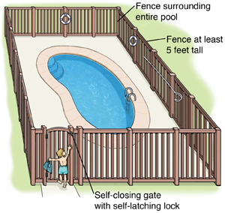
Prevention: Swimming Pools & Spas
A pool must have barrier surrounding the pool or spa completely, including 5-foot tall fence with self-closing, self-latching gates
Doors heading to the pool should have an alarm
Pools should have an alarm and a power safety cover
Sliding glass doors alone are not effective barrier to pools
Source: https://www.safekids.org/poolsafety
Notes:
Information taken from:
https://www.safekids.org/poolsafety
https://leginfo.legislature.ca.gov/faces/codes_displayText.xhtml?lawCode=HSC&division=104.&title=&part=10.&chapter=5.&article=2.5.
Image taken from:
https://www.lucieslist.com/guides/baby-proofing/pool-safety/

Slide 12
California Law: Swimming Pools & Spas
According to the California Pool Safety Act of 2018, for the construction of a new pool or spa or the remodeling of an existing pool or spa at a private single-family home, it must be equipped with at least TWO of the following seven drowning prevention safety features:
An enclosure
Removable mesh fence
A safety pool cover
Exit alarms on the home’s doors that provide direct access to the swimming pool or spa
A self-closing, self-latching device with a release mechanisms placed no lower than 54 inches above the floor on the home’s doors providing direct access to the swimming pool or spa
An alarm that will sound upon detection of accidental or unauthorized entrance into the water
Other means of protection, if the degree of protection afforded is equal or greater than that afforded by the features set forth above
Source: https://leginfo.legislature.ca.gov/faces/codes_displayText.xhtml?lawCode=HSC&division=104.&title=&part=10.&chapter=5.&article=2.5.
Notes:
California Law states that, for the construction of a new pool or spa or the remodeling of an existing pool or spa at a private single-family home, it must be equipped with at least TWO of the following seven drowning prevention safety features:
An enclosure
Removable mesh fence
A safety pool cover
Exit alarms on the home’s doors that provide direct access to the swimming pool or spa
A self-closing, self-latching device with a release mechanisms placed no lower than 54 inches above the floor on the home’s doors providing direct access to the swimming pool or spa
An alarm that will sound upon detection of accidental or unauthorized entrance into the water
Other means of protection, if the degree of protection afforded is equal or greater than that afforded by the features set forth above
Information taken from:
https://leginfo.legislature.ca.gov/faces/codes_displayText.xhtml?lawCode=HSC&division=104.&title=&part=10.&chapter=5.&article=2.5.
Please refer to the California Pool Safety Act 2018 at the above link for further details of requirements outlined on this slide

Slide 13
Prevention
Unsafe In-Home Products in Areas with Heat & Flames

Slide 14
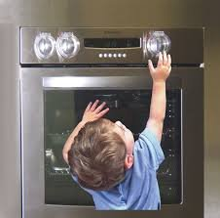
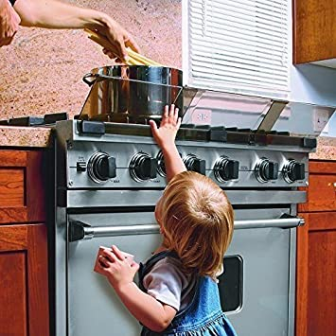
Prevention: Kitchens
Every day, about 300 children ages 0-19 are seen in emergency rooms for burn or scald injuries, many of which come from the kitchen
To prevent burns and scalds in the kitchen:
Use knob covers, stove covers, and oven locks
Keep appliances far back on the counter and unplugged when not in use
Sources:
https://www.safewise.com/resources/baby-safety/
https://www.safekids.org
Notes:
Information taken from:
https://www.safewise.com/resources/baby-safety/
https://www.safekids.org/press-release/six-essential-child-proofing-steps-often-overlooked-parents-and-caregivers#:~:text=Safe%20Kids%20Worldwide%20is%20a,children%20in%20the%20United%20States.&text=Safe%20Kids%20is%20a%20go,%2C%20falls%2C%20poisoning%20and%20more.
Photos taken from:
https://www.amazon.com/Proofing-Household-Stove-Protection-Oven-Locks-Knob-Protector/dp/B07DCLNSR6
https://www.amazon.com/Baby-Nursery-Adjustable-Stove-Safety/dp/B01CXQFGOI

Slide 15
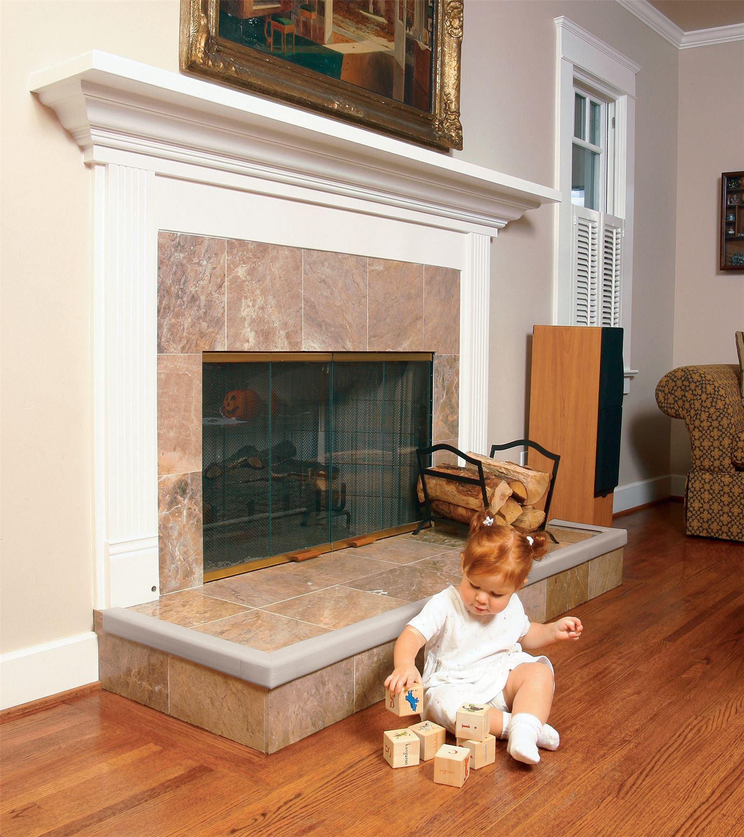
Prevention: Fireplaces
Install a fireplace guard
Use edge protectors for sharp corners
Sources:
https://www.nsc.org/home-safety/safety-topics/child-safety/childproofing
https://www.safewise.com/resources/baby-safety/
Notes:
Information taken from:
https://www.nsc.org/home-safety/safety-topics/child-safety/childproofing
https://www.safewise.com/resources/baby-safety/
Photos taken from:
https://www.amazon.com/Safety-Fireplace-Hearth-Protection-Fireguard/dp/B07Q5YB47Y
https://www.ebay.com/itm/Prince-Lionheart-Fireplace-Guards-Baby-Kid-Proofing-Safety-Bumper-Protector-/132780087446

Slide 16
Prevention
Unsafe In-Home Products in Areas with Toxic Substances

Slide 17
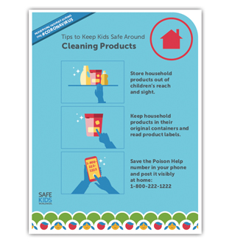
Prevention: Areas with Toxic Substances
Under Kitchen & Bathroom Sinks
Medicine Cabinets
Laundry Rooms
Garages & Sheds
Keep bathroom counters clear of cosmetics and personal care items locked away, as many hygiene products contain chemicals as harmful as cleaning supplies
Secure cleaning products, antifreeze, windshield wiper fluid, gasoline, kerosene, lamp oil, insecticide, chemicals, tools, and other items commonly kept in garages
Keep medicines, supplements, and vitamins securely locked away in an out-of-reach medicine cabinet
Detergent in single-use laundry packets is highly concentrated and toxic, and even a small amount can cause serious breathing or stomach problems
Keep cleaning supplies in out-of-reach locked cabinets
Keep fire extinguishers out of reach of children – fire retardant is toxic to ingest even in small doses
Sources:
https://www.safewise.com/resources/baby-safety/ | https://www.healthychildren.org/English/safety-prevention/at-home/Pages/Childproofing-Your-Home.aspx | https://www.safekids.org
Notes:
Prevention Practices:
A poison control center receives a call about a child getting into a poison every minute
Every year, over 3,300 button battery swallowing cases are reported to U.S. poison control centers
In 2018, there were 9,444 calls to poison control centers related to laundry packet incidents involving young children
Most poisonings occur when parents and caregivers are home but not paying attention
Poison Control Hotline:
1-800-222-1222
Information taken from:
https://www.safewise.com/resources/baby-safety/
https://www.healthychildren.org/English/safety-prevention/at-home/Pages/Childproofing-Your-Home.aspx
https://www.safekids.org/press-release/six-essential-child-proofing-steps-often-overlooked-parents-and-caregivers#:~:text=Safe%20Kids%20Worldwide%20is%20a,children%20in%20the%20United%20States.&text=Safe%20Kids%20is%20a%20go,%2C%20falls%2C%20poisoning%20and%20more.
Infographic taken from:
https://www.safekids.org/infographic/keep-kids-safe-around-cleaning-products

Slide 18
Packets Up! American Cleaning Institute
Source: https://www.cleaninginstitute.org/liquidlaundrypacketsafety
Notes:
Play the above video for an overview liquid laundry packet safety. Click the video twice to play.
Prevention Practices:
Cleaning products and detergents
Keep cleaning supplies and detergents in out-of-reach or locked cabinets
Detergent in single-use laundry packets is highly concentrated and toxic, and even a small amount can cause serious breathing or stomach problems
Washer and dryer
Anchor to the wall
Ensure they are closed, latched, and locked to prevent children from hiding or falling in
Information taken from:
https://www.safewise.com/resources/baby-safety/
https://www.healthychildren.org/English/safety-prevention/at-home/Pages/Childproofing-Your-Home.aspx
Video link:
https://www.cleaninginstitute.org/liquidlaundrypacketsafety

Slide 19
Prevention
Unsafe In-Home Products in Areas with the Potential for a Fall

Slide 20
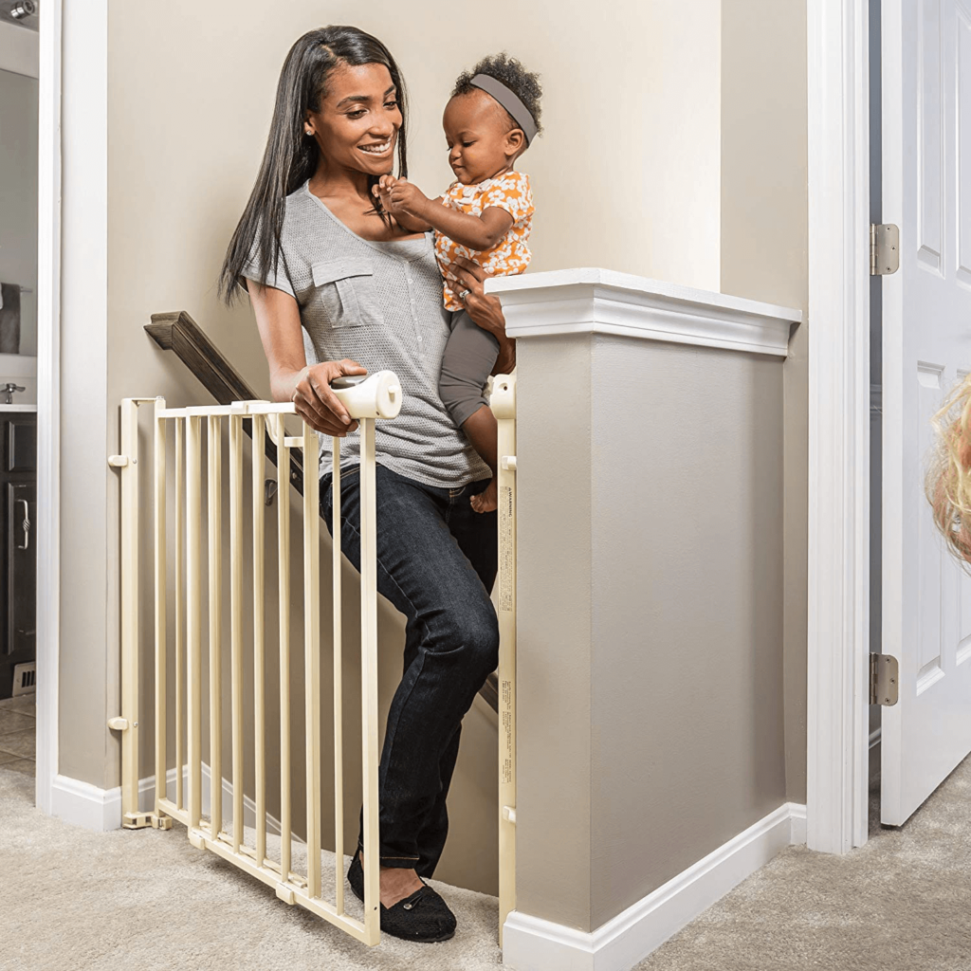
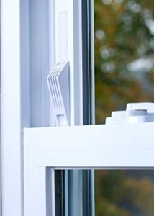
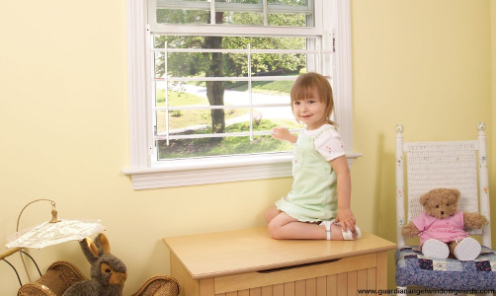
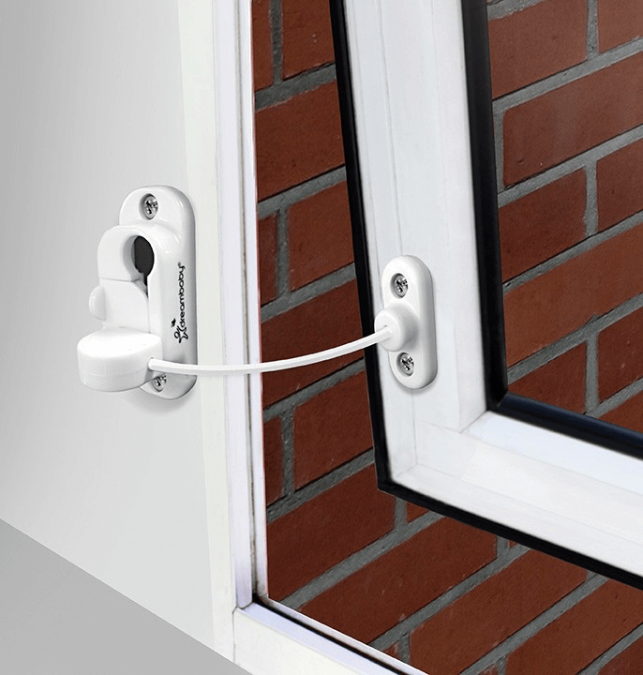
Prevention: Stairs, Windows, & Slippery Floors
Install window guards that prevent windows from opening more than 4 inches
Use hardware-mounted safety gates at the top and bottom of stairs
Also install window stops…
Secure rugs and loose carpeting to the floor with grippers and nonstick pads
Sources:
https://www.safewise.com/resources/baby-safety/
https://www.nsc.org/home-safety/safety-topics/child-safety/childproofing
…and window locks
Notes:
Prevention Practices:
Stairs
Use safety gates at the top and bottom on stairs
Windows
Use window guards, window, and window locks to prevent windows from opening more than 4 inches
Rugs
Secure rugs and loose carpeting to the floor with grippers and nonstock pads to prevent falls
Additional Prevention Practices:
Changing tables
To prevent babies from falling off changing tables, keep supplies within reach and one hand on your baby always
Consider changing on the floor, especially as babies become more mobile
Apply bumpers and edge covers on sharp corners of furniture
Information taken from:
https://www.safewise.com/resources/baby-safety/
https://www.nsc.org/home-safety/safety-topics/child-safety/childproofing
Photos taken from:
Stairs: https://www.lucieslist.com/guides/baby-proofing/baby-gates/
Windows: https://www.lucieslist.com/guides/baby-proofing/window-safety/
Rug: https://www.amazon.com/DoubleCheck-Products-Extra-Strong-Padding/dp/B01CTBL26S

Slide 21
Prevention: Furniture Tip-Overs
✓
Anchor all furniture to the wall
✗
Never allow children to open and climb on furniture and drawers
✓
Use an anchoring system for TVs
✗
Never place a TV on top of a dresser where it could fall on your child
Source: https://anchorit.gov/
Notes:
15 children are admitted to emergency rooms every day due to a TV tip-over
Information taken from:
https://anchorit.gov/
https://www.safekids.org/press-release/six-essential-child-proofing-steps-often-overlooked-parents-and-caregivers#:~:text=Safe%20Kids%20Worldwide%20is%20a,children%20in%20the%20United%20States.&text=Safe%20Kids%20is%20a%20go,%2C%20falls%2C%20poisoning%20and%20more.
https://www.safewise.com/resources/baby-safety/
Photos taken from:
https://www.instagram.com/p/CE-JbDopSP4/
https://www.anchorit.gov/how-to-anchor-it/parents-and-caregivers/

Slide 22
Anchor It! U.S. Consumer Product Safety Commission AnchorIt.gov
Source: https://www.cpsc.gov/Newsroom/News-Releases/2020/Even-When-Youre-Watching-Anchor-It-Campaign-Video-Shows-How-Quickly-Children-Can-Be-Injured-or-Killed-Urges-Families-to-Secure-Furniture-and-Televisions
Notes:
Play the video above to accompany the previous slide about the importance of preventing furniture tip-overs by anchoring these products to the wall.
Video link:
https://www.cpsc.gov/Newsroom/News-Releases/2020/Even-When-Youre-Watching-Anchor-It-Campaign-Video-Shows-How-Quickly-Children-Can-Be-Injured-or-Killed-Urges-Families-to-Secure-Furniture-and-Televisions

Slide 23
Prevention
Unsafe In-Home Products in Areas with Choking and Suffocation Hazards

Slide 24
Prevention: Unsafe Sleep Environments
About 3,500 babies less than 1 year old die of sleep-related deaths each year
Sleep Safety
Bedding and stuffed animals are a suffocation risk for young babies
Crib Safety
Do not use drop cribs or secondhand cribs
Only use hardware obtained directly from the crib’s manufacturer
Check to ensure that your crib has not been recalled and meets current safety standards
www.jmpa.org
www.cpsc.gov
www.recalls.gov
Sources:
https://www.safewise.com/resources/baby-safety/
http://www.thecapcenter.org/what/child-safety/safesleepbaby
https://www.nsc.org/home-safety/safety-topics/child-safety/childproofing
https://www.jpma.org/page/bsm_safety_tips
Notes:
Children are most likely to suffocate in unsafe sleep environments
About 3,500 sleep-related deaths occur among babies less than 1 year old in the U.S. every year. These deaths are often classified as sudden unexpected infant deaths (SUID) and include three common types:
Sudden infant death syndrome (SIDS)
Unknown cause
Accidental suffocation and strangulation in bed
Information taken from:
https://www.cdc.gov/sids/data.htm#:~:text=In%202018%2C%20there%20were%20about,suffocation%20and%20strangulation%20in%20bed.
https://www.cdc.gov/reproductivehealth/features/baby-safe-sleep/index.html#:~:text=There%20are%20about%203%2C500%20sleep,related%20infant%20deaths%2C%20including%20SIDS.
https://www.safewise.com/resources/baby-safety/
http://www.thecapcenter.org/what/child-safety/safesleepbaby
https://www.nsc.org/home-safety/safety-topics/child-safety/childproofing
https://www.jpma.org/page/bsm_safety_tips
Photo taken from:
http://www.thecapcenter.org/what/child-safety/safesleepbaby

Slide 25
Prevention: Cords on Window Blinds
Keep all window cords out of children’s reach
Move all cribs, beds, furniture, and toys away from windows and window cords
Tasseled pull cords should be as short as possible
Continuous-loop cords on draperies and vertical blinds should be permanently anchored to the floor or wall
Make sure cord stops are properly installed and adjusted to prevent the movement of inner lift cords
Eliminate all dangling cords whenever possible
If you have blinds from the year 2000 or earlier and cannot afford new, cordless window coverings, contact the Window Covering Safety Council for a free repair kit
Source: https://windowcoverings.org/
Notes:
Information and photo taken from:
https://windowcoverings.org/
Contact information for Window Covering Safety Council:
1-800-506-4636
https://windowcoverings.org/retrofit-your-windows/

Slide 26
Little Hands Window Covering Safety Council
Source: https://windowcoverings.org/window-cord-safety/spread-the-word/
Notes:
Play the above video for an overview of the importance of window covering safety. Click the video twice to play.
Video link:
https://windowcoverings.org/window-cord-safety/spread-the-word/

Slide 27
Prevention: Additional Choking & Suffocation Hazards
Magnets
Keep small magnets up high and out of reach
Batteries
Keep batteries locked away and out of reach
Ensure that batteries are secured behind screw-on covers
Knickknacks
Keep smaller objects and glass figurines up high and out of reach
Electrical Cords
Mobiles
Pet Food
Use ties, tape, or boxes designed to keep cords together
Store behind furniture or out of sight
Once your child can reach and pull down a mobile, remove it from their crib
Closely supervise your pet’s mealtime and place food up when done
Sources:
https://www.safewise.com/resources/baby-safety/
https://www.nsc.org/home-safety/safety-topics/child-safety/childproofing
https://www.healthychildren.org/English/safety-prevention/at-home/Pages/Childproofing-Your-Home.aspx
Notes:
Prevention practices:
Magnets
Small magnets can be swallowed
Strong magnets can cause serious damage if ingested
Knickknacks
Smaller objects and glass figurines are choking hazards and potentially hazardous if they break
Electrical cords
Both a strangulation and electrocution hazard
Use ties, tape, or boxes designed to keep cords together
Place behind furniture
Mobiles
Once a baby can reach and pull down a mobile, move it higher or remove it altogether
Pet food
Choking hazard
Closely supervise pet’s mealtime and put food up when done
Batteries
Small button batteries are especially hazardous
Ensure batteries are secured behind screw-on covers and secure with duct tape if necessary
Input the Button Battery Ingestion Hotline into your phone: 1-800-498-8666
Additional entrapment hazard:
Toy boxes
Toy boxes should have a hinge guard and only close manually, so as not to trap a child inside
Information taken from:
https://www.safewise.com/resources/baby-safety/
https://www.nsc.org/home-safety/safety-topics/child-safety/childproofing
https://www.healthychildren.org/English/safety-prevention/at-home/Pages/Childproofing-Your-Home.aspx

Slide 28
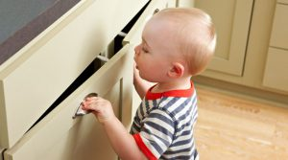
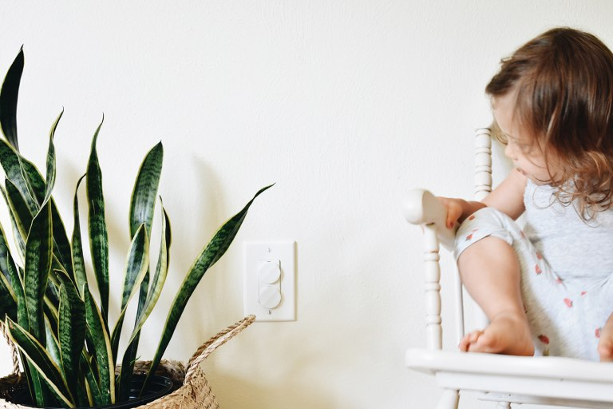
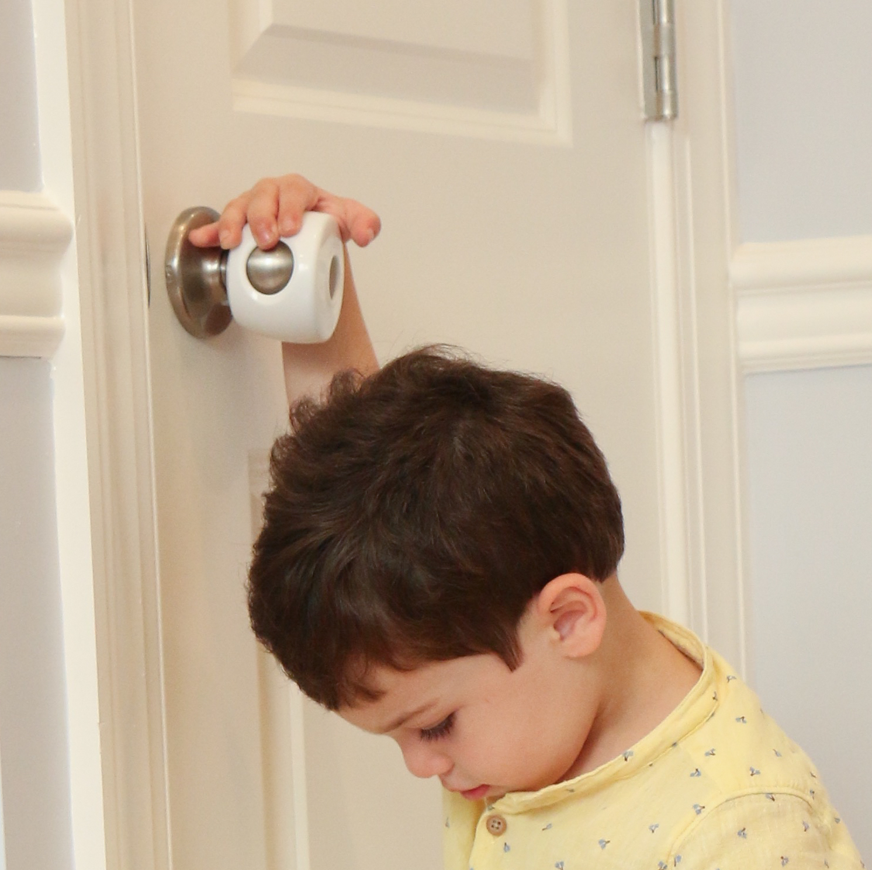
Prevention: Additional Safety Considerations
Keep potentially poisonous and long-vined plants up high up and out of reach
Use safety latches to secure cupboards
Use outlet covers to prevent children from sticking their fingers or other objects in electrical outlets
Use doorknob locks, hinge guards, and doorstops to prevent children from hurting their fingers or entering rooms
Sources:
https://www.safewise.com/resources/baby-safety/
https://www.healthychildren.org/English/safety-prevention/at-home/Pages/Childproofing-Your-Home.aspx
Notes:
Prevention Practices:
Cupboards
Inspect contents and decide what needs to be moved or locked away
Definitely secure the following: cleaning products, liquor and tobacco products, sharp objects, anything made of glass, and plastic and paper bags
Doors
Use doorknob locks, hinge guards, and doorstops to prevent children from hurting their fingers or entering rooms
Outlets
Use outlet covers to prevent children from sticking their fingers or other objects in electrical outlets
Houseplants
Some are poisonous and others have long vines
Keep plants high up and out of reach
Additional Prevention Practices:
Cars
If your car is parked in the garage, keep the doors closed and locked
Buckets and bins
Keeps buckets, bins, and other receptacles that could gather water turned over to avoid becoming filled with water, which could pose a drowning risk
Information taken from:
https://www.safewise.com/resources/baby-safety/
https://www.healthychildren.org/English/safety-prevention/at-home/Pages/Childproofing-Your-Home.aspx
Photos taken from:
Safety latch: https://www.homecheckmyhouse.com/child-safety/
Doorknob cover: https://www.walmart.com/ip/Child-Safety-Door-Knob-Covers-4-Pack-Baby-Proof-Knobs-Child-Proof-Doors-by-Jool-Baby/907352419
Outlet cover: https://www.babylist.com/hello-baby/best-outlet-covers
Plants: https://flo.health/being-a-mom/your-baby/baby-health-and-safety/poisonous-houseplants

Slide 29
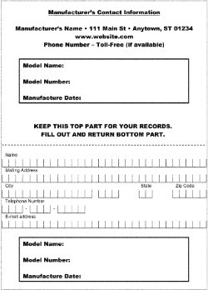
Recalls & Registration of In-Home Products
Register your baby’s products
Product registration allows the manufacturer to directly communicate any issues, including recalls
Register by filling out and mailing back the card that comes in the box or visit the manufacturer website and complete and submit the online registration form
Check for recalls
Juvenile products are recalled through the Consumer Product Safety Commission
https://www.cpsc.gov/Recalls
Car seats are recalled through the National Traffic Safety Administration
https://www.nhtsa.gov/recalls
Additional up to date recall information can be found through the U.S. government
https://recalls.gov/
Source: https://www.jpma.org/page/parents_recalls_registration_cards
Notes:
Note:
The information provided on product registration cards are not used for advertising purposes
Information taken from:
https://www.jpma.org/page/parents_recalls_registration_cards

Slide 30
Summary: 12 Safety Devices to Protect your Children
Safety latches and locks
Safety gates
Doorknob covers and door locks
Anti-scald devices
Smoke alarms
Window guards and safety netting
Corner edges and bumpers
Outlet covers and outlet plates
Carbon monoxide (CO) alarms
Cordless window coverings
Anchors to avoid furniture and appliance tip-overs
Layers of protection with pools and spas
Source: https://www.cpsc.gov/safety-education/safety-guides/kids-and-babies/childproofing-your-home-12-safety-devices-protect
Notes:
Information and infographic taken from:
https://www.cpsc.gov/safety-education/safety-guides/kids-and-babies/childproofing-your-home-12-safety-devices-protect
Safety latches and locks on cabinets and drawers
Prevent poisonings and other injuries by avoiding access to medicines, cleaners, matches, lighters, or knives and other sharp objects
Safety gates
Helps prevent falls downstairs and keep children from entering rooms and other areas with possible dangers
For top of stairs, use gates that screw to the wall as they are sturdier than pressure-mounted gates
Make sure gates meet to current safety standards
Replace older gates that have “V” shape that are large enough for children’s heads and necks to become stuck
Doorknob covers and door locks
Prevents children from entering rooms or other areas with potential dangers
Anti-scald devices
Can regulate water temperature to prevent burns
Set water heater to 120 degrees Fahrenheit
Smoke alarms
Install on every level of home, inside each room, and outside sleeping areas
Check monthly to make sure they’re working
Change batteries annually or consider 10-year batteries
Window guards and safety netting
Prevents falls from windows, balconies, decks, and landings
Limit window openings to four inches or less
Window screens are not effective for preventing window falls
Ensure an adult is still able to escape in case of a fire
Corner and edge bumpers
Prevents injuries from falls against sharp edges of furniture and fireplaces
Ensure bumpers stay securely on furniture
Outlet covers and plates
Prevents electrocution
Outlet covers should not be easily removed by children or small enough to be a choking hazard
Carbon monoxide alarm
Should be installed near sleeping areas in the home
Change batteries at least once a year
Cordless window coverings
Prevents strangulation
If you have blinds from 2000 or earlier and cannot afford new, cordless window covering, call Window Covering Safety Council at 800-506-4636 or visit WindowCoverings.org for a free repair kit
WCSC’s retrofit kits do not address the hazard associated with dangling pull cords
Anchors to prevent furniture and appliance tip-overs
Anchor these products to the floor or wall to prevent deadly or injurious falls
Free standing ranges and stoves should be installed with anti-tip brackets
Layers of protection with pools and spas
A pool must have barrier completely surrounding pool or spa including 4-foot tall fence with self-closing, self-latching gates
Doors heading to the pool should have an alarm or the pool should have a power safety cover
Pool alarms can add an additional layer of protection
Sliding glass doors alone are not effective barrier to pools

Slide 31
How to Prepare for & Prevent Household Accidents
Follow the guidelines in this presentation to fully childproof your home
Learn CPR and age-appropriate Heimlich maneuver
Keep the following numbers in your contacts or near your phone
Poison control: 1-800-222-1222
Button Battery Hotline: 1-800-498-8666
Doctor’s numbers
Parents’ work and cell phone numbers
Neighbor’s or nearby relative’s number
Make a first-aid kit with emergency instructions inside
Install smoke alarms and carbon monoxide detectors
Source: https://kidshealth.org/en/parents/childproof.html
Notes:
Information taken from:
https://kidshealth.org/en/parents/childproof.html

Slide 32
Unsafe In-Home Products: Local Resources & Contact Information
Community resources near you:
[Include county-specific and local resources here]
Thank you!
Notes:
General Resources
Recalls:
https://www.cpsc.gov/Recalls
https://www.nhtsa.gov/recalls
https://www.usa.gov/recalls
https://recalls.gov/
Juvenile Products Manufacturing Association Certification Directory:
https://www.jpma.org/search/custom.asp?id=3548
International Association for Child Safety – Find a Child Safety Consultant:
http://www.iafcs.org/findachildproofer.asp?fl=CHP&kbid=62750
Window Covering Safety Council – Retrofit your Windows & Free Retrofit Kit:
https://windowcoverings.org/retrofit-your-windows/
Checklists:
https://www.childproofingexperts.com/childproofing-checklist-by-age/
https://www.acf.hhs.gov/ecd/childproofing-checklist
https://secure.caes.uga.edu/extension/publications/files/pdf/C%201049_2.PDF
https://kidshealth.org/en/parents/household-checklist.html
Infographics:
https://www.safekids.org/infographic/childproofing-steps-six-items-keep-and-away
https://www.safekids.org/infographic/products-keep-out-reach-infographic
https://www.cleaninginstitute.org/sites/default/files/assets/1/AssetManager/07-PACKETS-UP-infographic.jpg
https://www.cleaninginstitute.org/sites/default/files/assets/1/AssetManager/ASTM-Infographic.PDF
https://windowcoverings.org/wp-content/uploads/2018/12/Standard-Infographic_Final.pdf
National Safety Council First Aid, CPR, and AED Courses:
https://www.nsc.org/safety-training/first-aid/courses
Can I Play With This? Activity Sheet for Children:
https://www.cleaninginstitute.org/sites/default/files/assets/1/Page/PACKETSUP-Activity-Sheet.pdf
Childproofing 360 Interactive Graphic:
https://www.thinglink.com/media/823196563353370624
Latest Product and Safety News:
https://www.safekids.org/latest-product-and-safety-news
American Cleaning Institute Liquid Laundry Packet Safety:
https://www.cleaninginstitute.org/liquidlaundrypacketsafety
Anchor It! How-To Videos, Tips, and Information for Securing Furniture:
https://www.anchorit.gov/how-to-anchor-it/parents-and-caregivers/

Slide 33
Photo Attributions
“Help Prevent Accidents at Home” Photo: https://www.cpsc.gov/safety-education/safety-guides/kids-and-babies/childproofing-your-home-12-safety-devices-protect
How to Prevent Bathtub Tragedies Graphic: https://www.today.com/health/tub-drownings-can-happen-minutes-when-it-safe-leave-child-t65606
Swimming Pool Graphic: https://www.lucieslist.com/guides/baby-proofing/pool-safety/
Knob Cover Photo: https://www.amazon.com/Proofing-Household-Stove-Protection-Oven-Locks-Knob-Protector/dp/B07DCLNSR6
Stove Guard Photo: https://www.amazon.com/Baby-Nursery-Adjustable-Stove-Safety/dp/B01CXQFGOI
Fireplace Guard Photo: https://www.amazon.com/Safety-Fireplace-Hearth-Protection-Fireguard/dp/B07Q5YB47Y
Fireplace Edge Protector Photo: https://www.ebay.com/itm/Prince-Lionheart-Fireplace-Guards-Baby-Kid-Proofing-Safety-Bumper-Protector-/132780087446
Cleaning Products Infographic: https://www.safekids.org/infographic/keep-kids-safe-around-cleaning-products
Photo of Mother & Child on Stairs: https://www.lucieslist.com/guides/baby-proofing/baby-gates/
Photo of Girl by Window, Window Stop Photo, and Window Lock Photo: https://www.lucieslist.com/guides/baby-proofing/window-safety/
Rug Photo: https://www.amazon.com/DoubleCheck-Products-Extra-Strong-Padding/dp/B01CTBL26S
Photo of Mother Anchoring Dresser, TV Anchoring System, and Child Reaching for TV: https://www.anchorit.gov/how-to-anchor-it/parents-and-caregivers/
Photo of Child Hanging from Dresser Drawer: https://www.instagram.com/p/CE-JbDopSP4/
ABC Safe Sleep Photo: http://www.thecapcenter.org/what/child-safety/safesleepbaby
Young Children & Window Cords Don’t Mix Image: https://windowcoverings.org/
Safety Latch Photo: https://www.homecheckmyhouse.com/child-safety/
Photo of Child Reaching for Plant: https://flo.health/being-a-mom/your-baby/baby-health-and-safety/poisonous-houseplants
Photo of Child Looking at Outlet Cover: https://www.babylist.com/hello-baby/best-outlet-covers
Photo of Child Holding Doorknob: https://www.walmart.com/ip/Child-Safety-Door-Knob-Covers-4-Pack-Baby-Proof-Knobs-Child-Proof-Doors-by-Jool-Baby/907352419
Image of Sample Product Registration Card: https://www.jpma.org/page/parents_recalls_registration_cards
Home Safety Devices Graphic: https://www.cpsc.gov/safety-education/safety-guides/kids-and-babies/childproofing-your-home-12-safety-devices-protect

